Slide 1
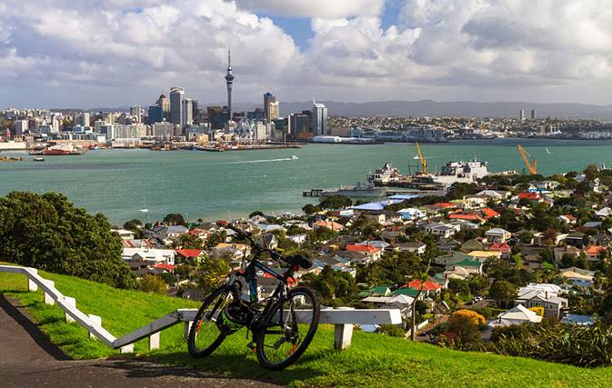
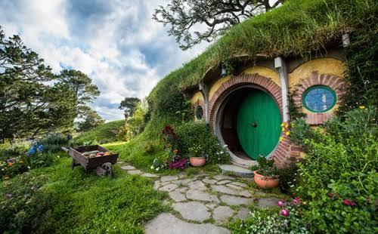

Slide 2
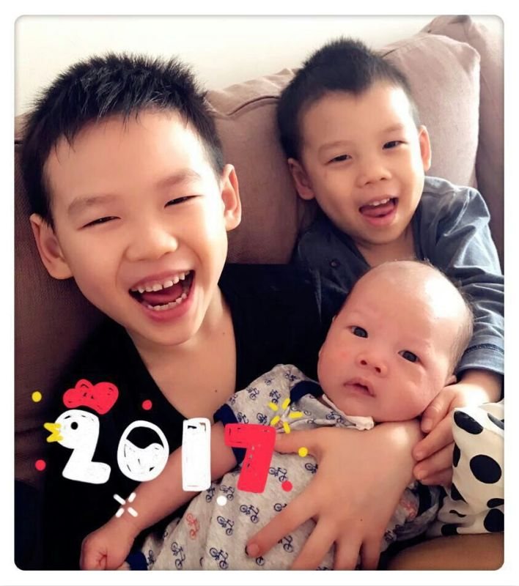
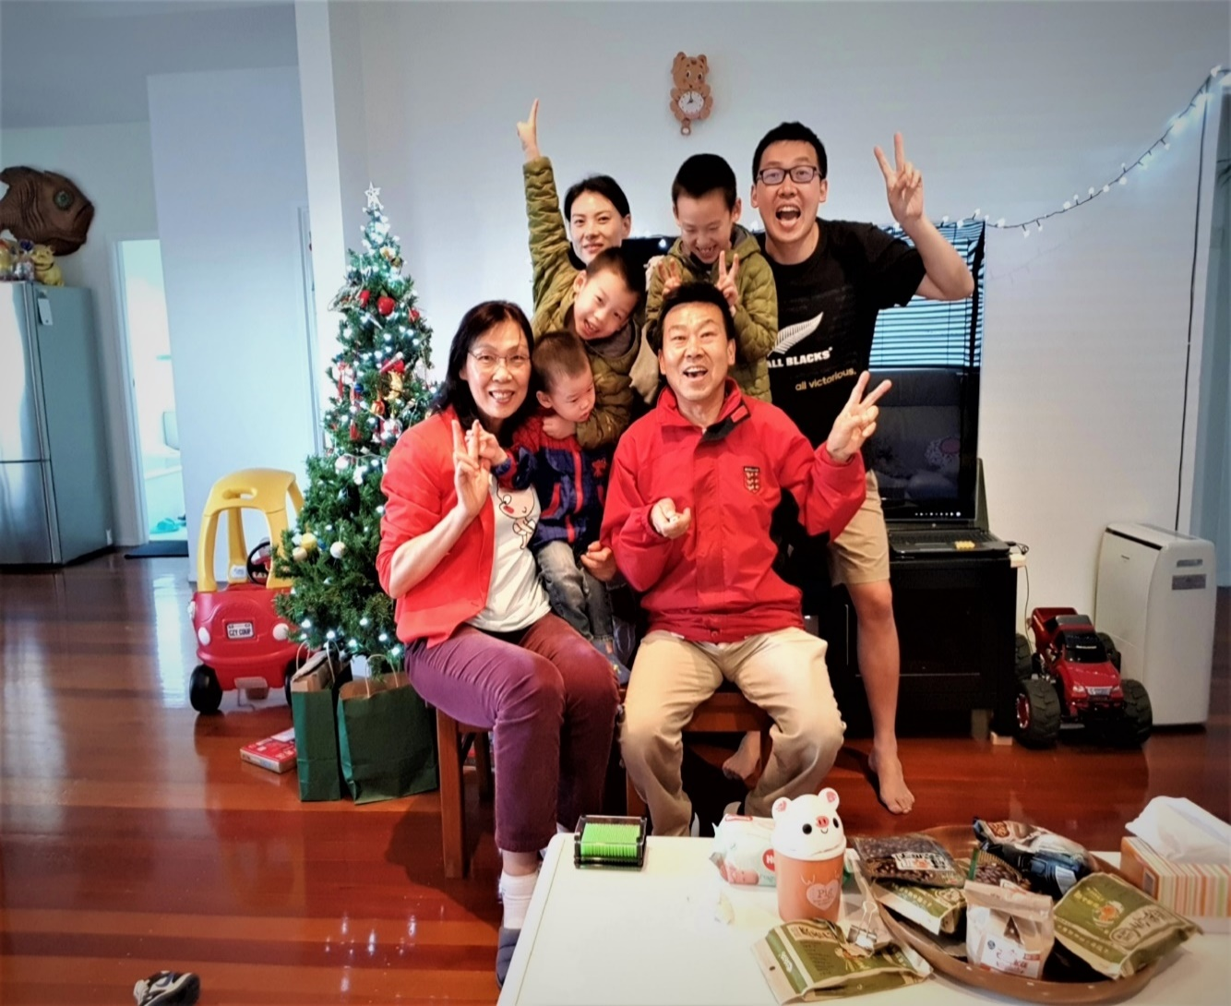
Jenny Wang QSM
Qualifications:
Diploma in social & Community work
Master in education theory (CN)
Bachelor of Science--Math (CN)
Work experiences:
Executive Director
Volunteer/Founder
Government Officer
University Lecturer
High School Teacher

Slide 3
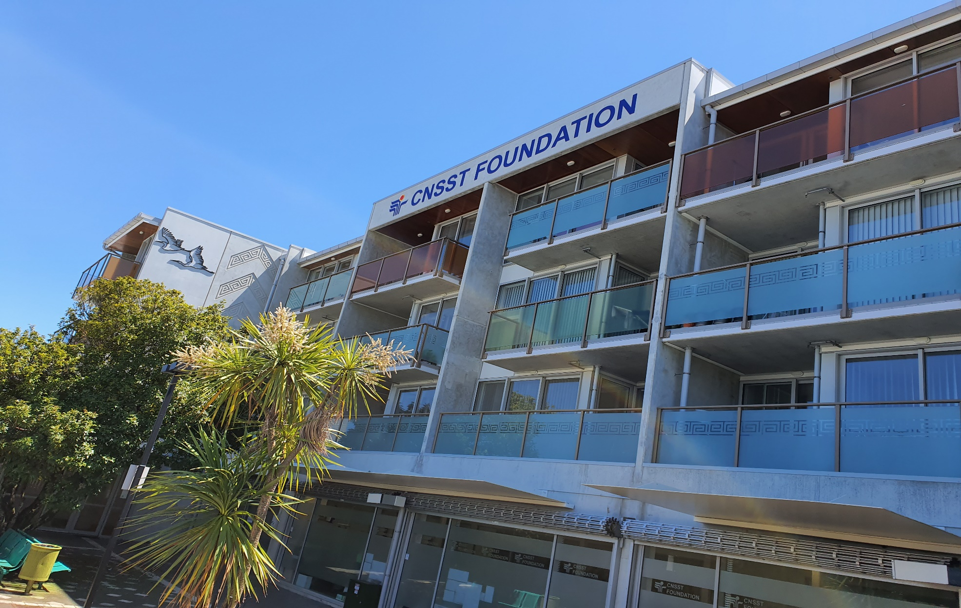
A Social Enterprise Started in a Home Garage

Slide 4
NZ’s population: 4,941,041 as at Friday, 08 Nov 2019 at 08:49:54 a.m. Super diversity Community--2013
Ethnic Group | New Zealand | Auckland
European/Pakeha欧裔 | 70.2% | 50%
Maori毛利裔 | 16.5% | 12%
Asians亚裔 | 15.1% | 23%
Pasifika太平洋岛裔 | 8.1% | 14%
Overseas-born海外出生 | 25.2% | 40%

Slide 5
Snapshot of NZ’s Business Sector （资料来源：May 2016，MBIE website)
Total of 502,170 enterprises and the number of Enterprises by employee size group:
0 employee: 353,070 (70%)
1-5 employees: 97,293 (19.4)
6-19 employees: 37,239 (7.4%)
20-49 employees: 9,459 (1.9%)
50 or more employees: 5,109 (1%)
small businesses are defined as those enterprises
with fewer than 20 employees ~ 96.8%

Slide 6
Snapshot of NZ’s Charitable Sector
27, 693 registered charities （Charities Services 2017）:
Tier 1 (over $30 M annual expenses): <1%
Tier 2 (under $30 M annual expenses): 6%
Tier 3 (under $2 M annual expenses): 36%
Tier 4 (under $125K annual expenses): 58%
* CNSST Foundation： T2 with 3.5m AE.

Slide 7
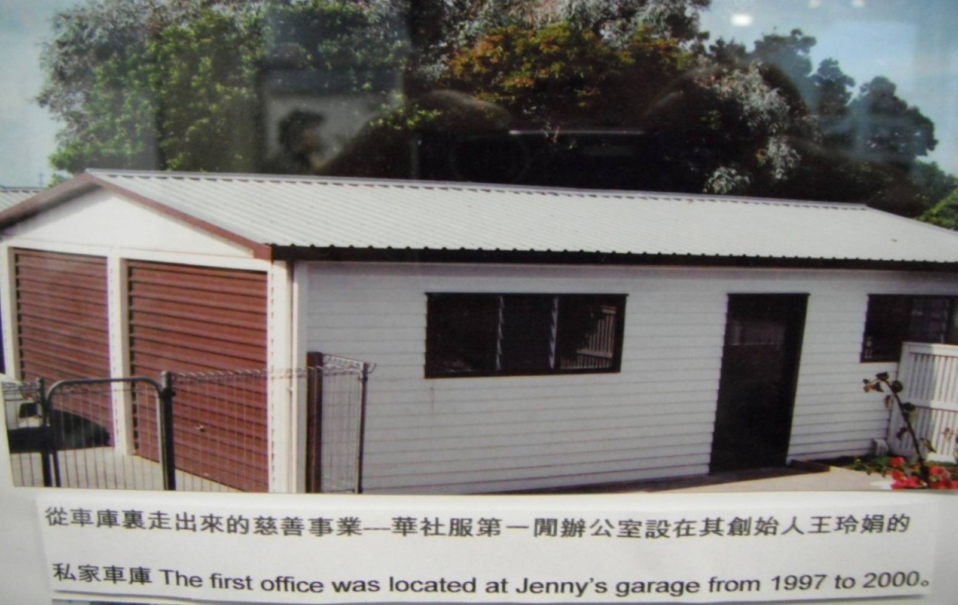
CNSST Foundation(CNSST华社服） （原名：Chinese New Settlers Services Trust 华人社区服务中心） -- CNSST started in Jenny’s home garage in 1998 从车库里走出来的慈善事业

Slide 8
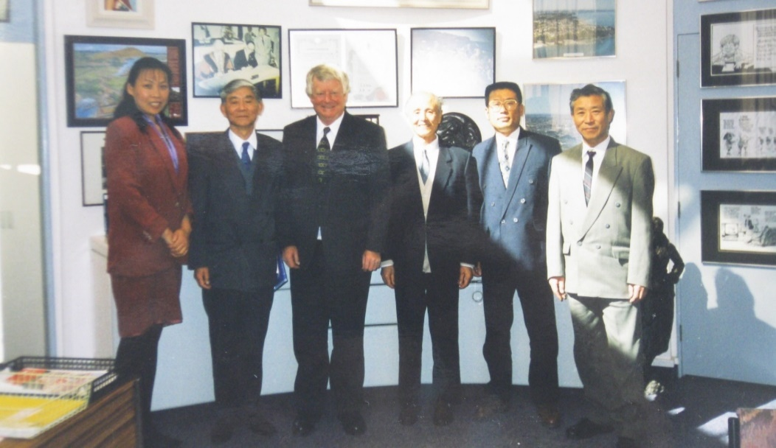
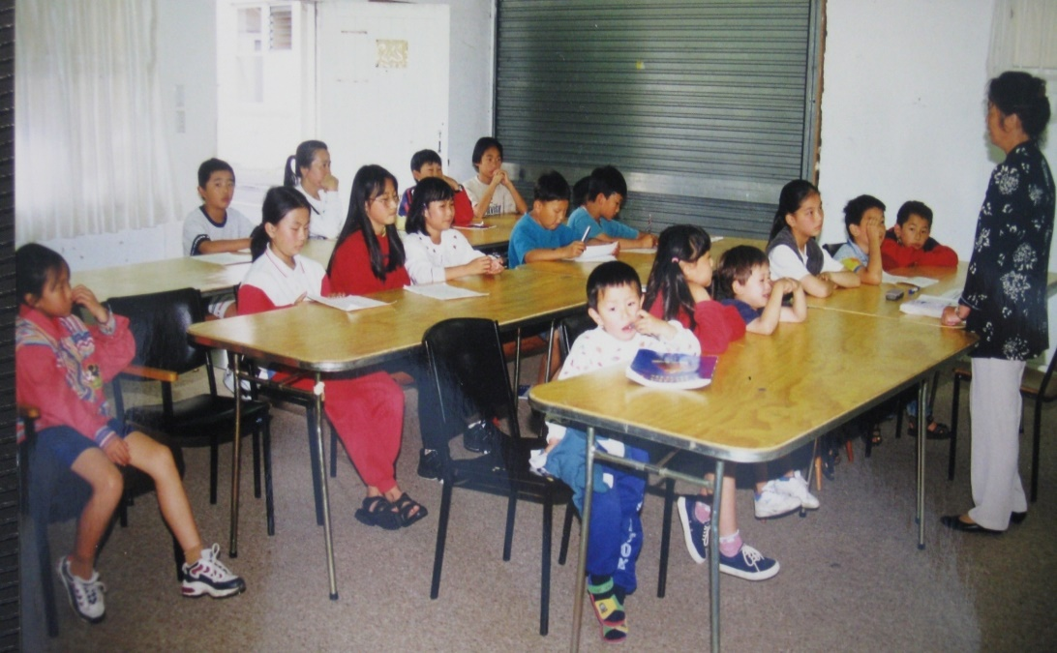
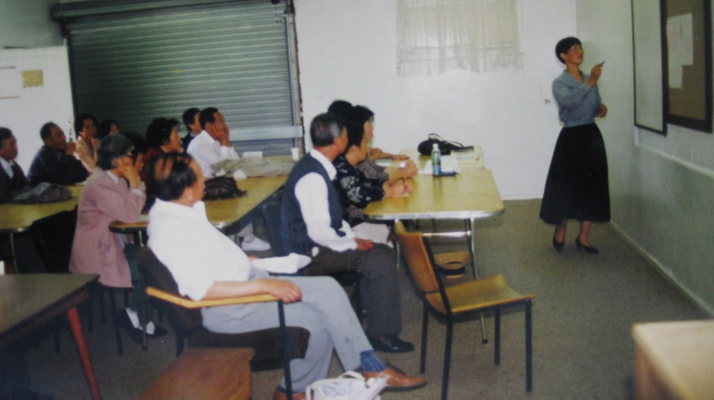
Initial Activities: Chinese language for youth, English language for seniors & TaiChi for local Chinese migrant community

Slide 9
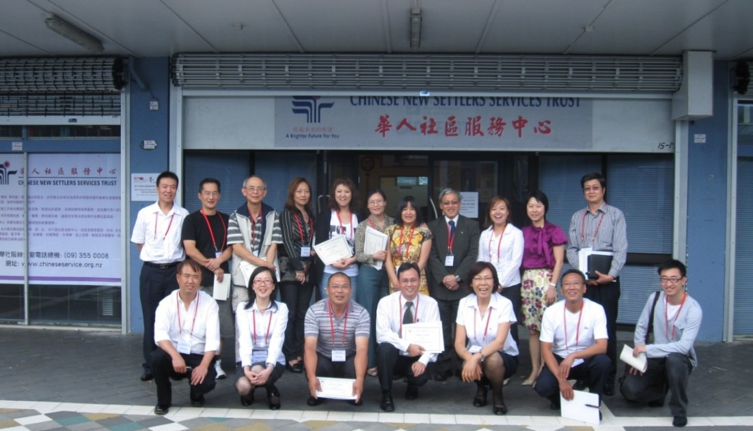
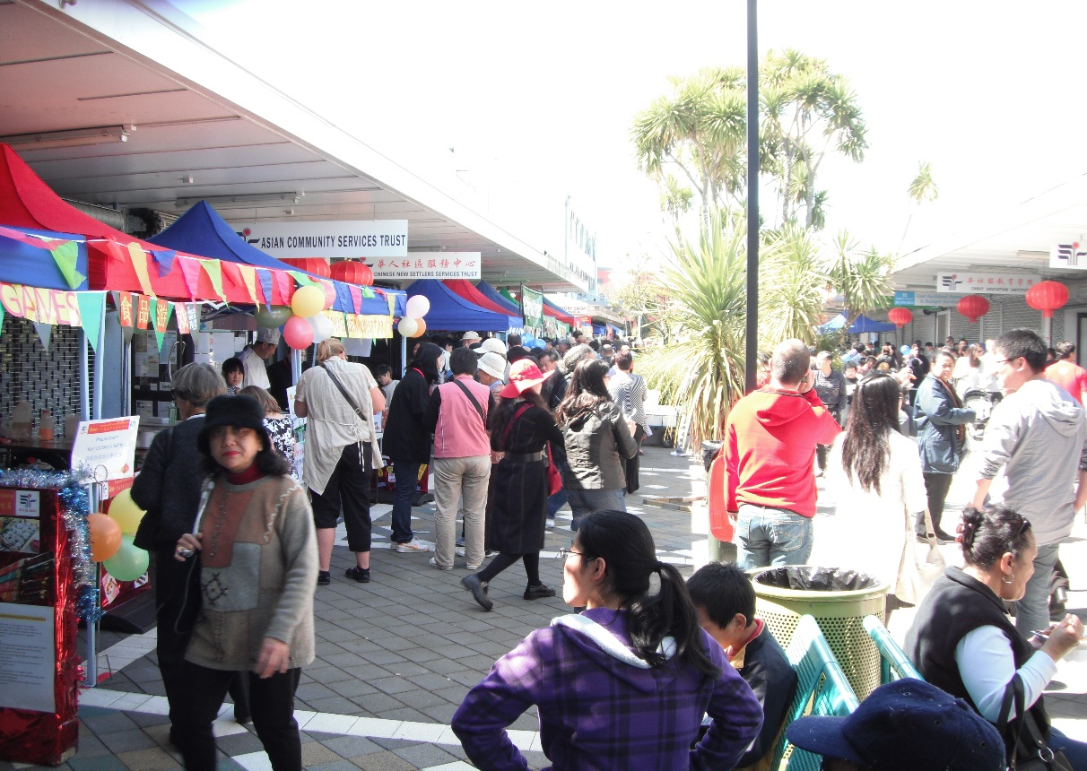
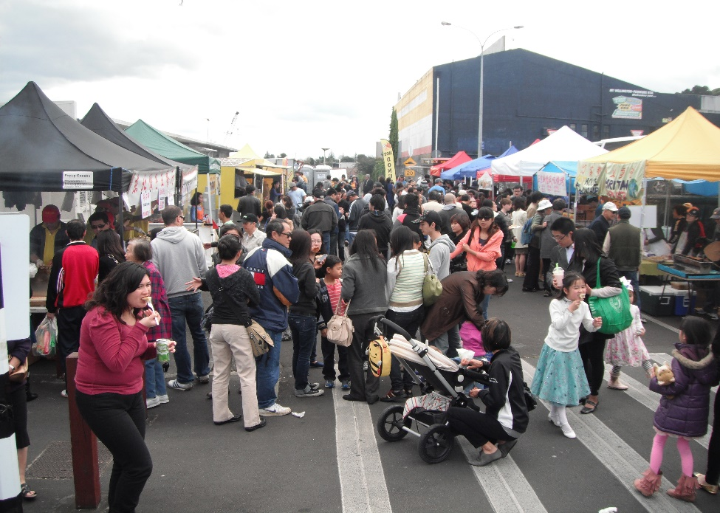
Our Mission:
To improve the quality
of life for Asian
New Zealanders

Slide 10
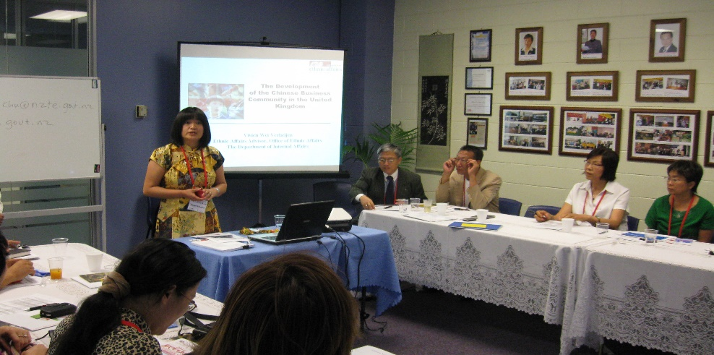
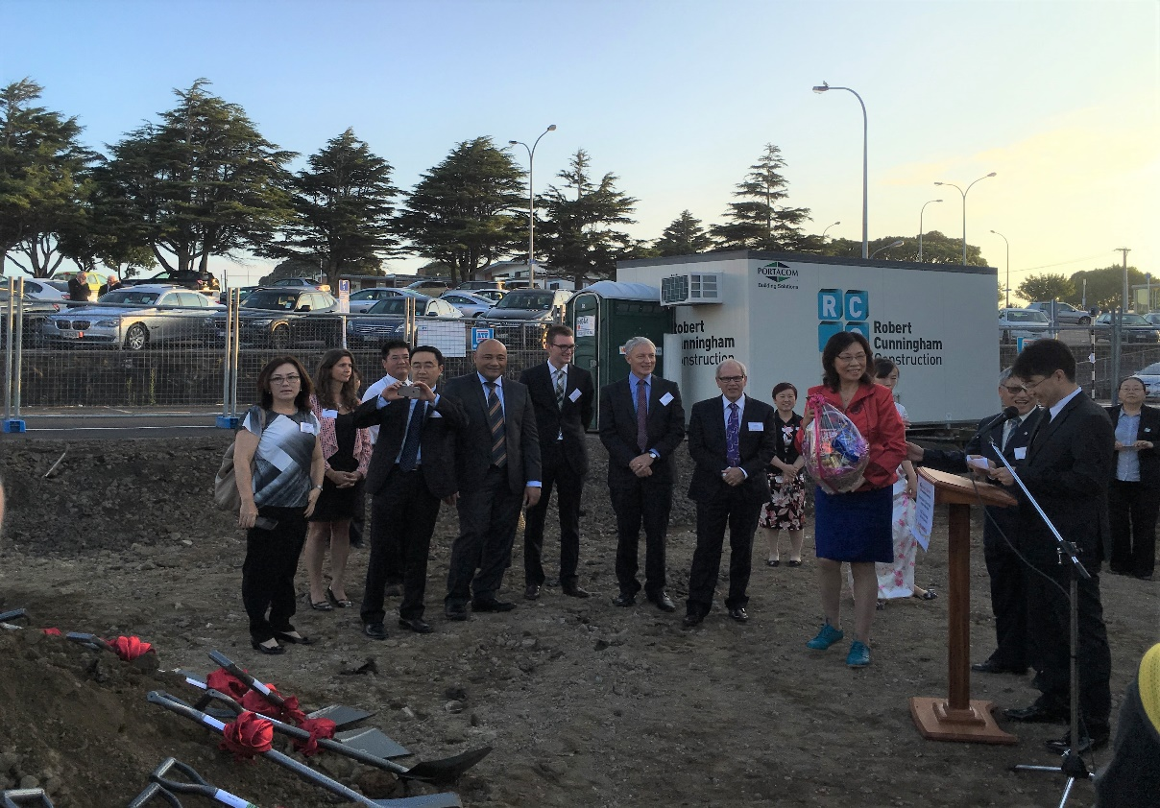
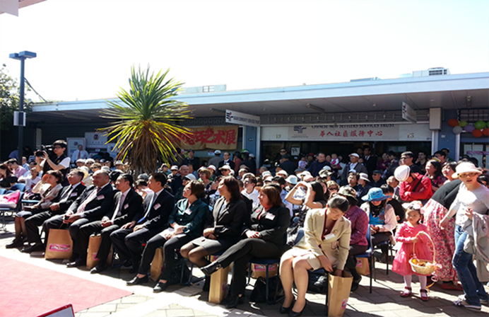
Our Vision:
To work towards meeting the
needs of Asian new settlers & to facilitate their successful integration into wider NZ society

Slide 11
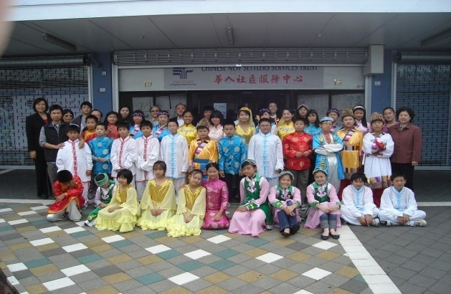
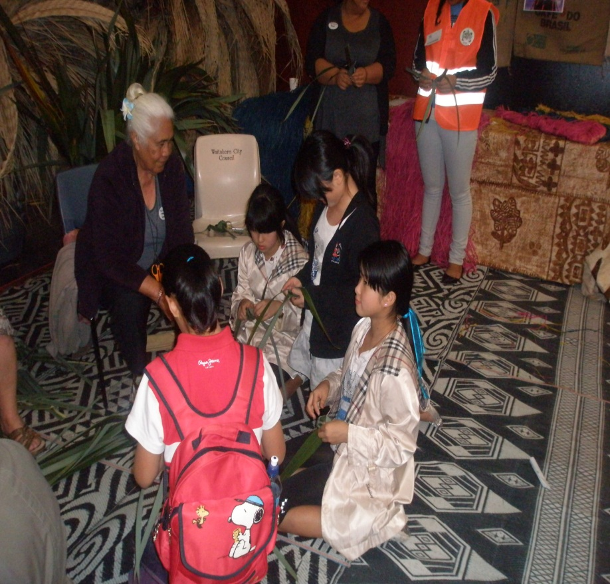
Our Services & Programmes:
Social Services: social work & counselling,
employment & settlement support, parenting & FV
programe, civic engagement projects & cultural events.
- Education: Chinese cultural & holiday programmes for youth, English for new comers, vocational training for adults.
Social Housing: partnership with NZ govt to develop social housing for local Asian seniors with wraparound support.
International projects: immigration, overseas study tour etc.

Slide 12
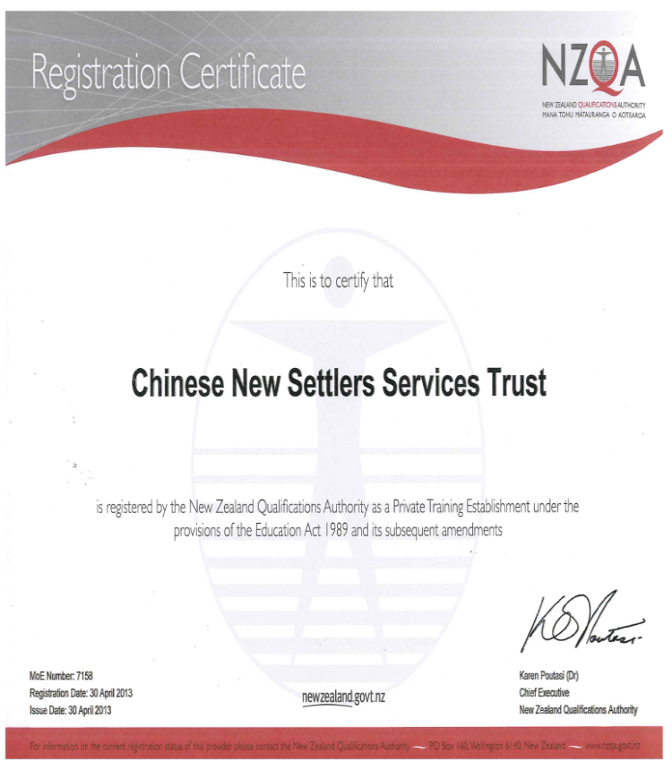
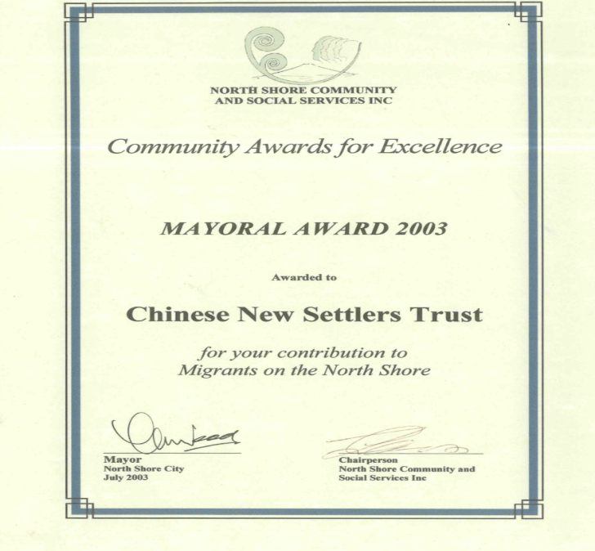
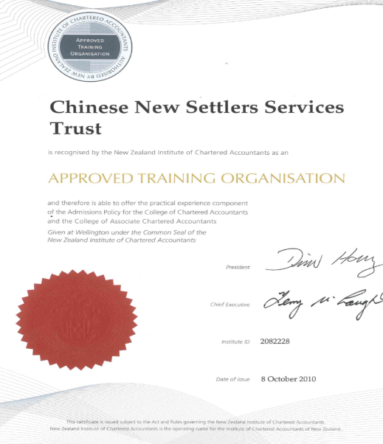
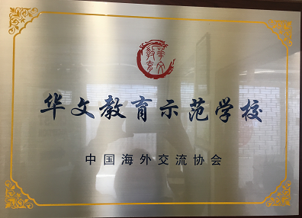
- MSD approved as a L2 community service provider
- MIBE approved as a social housing provider
- MOE/NZQA approved as a PTE
- NZICA approved as an ATE
- Received awards from local govts

Slide 14
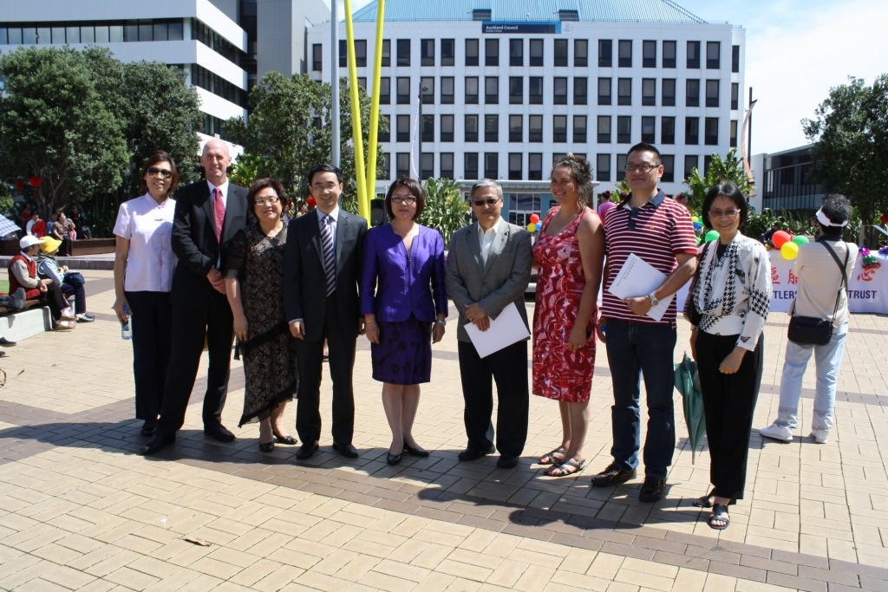
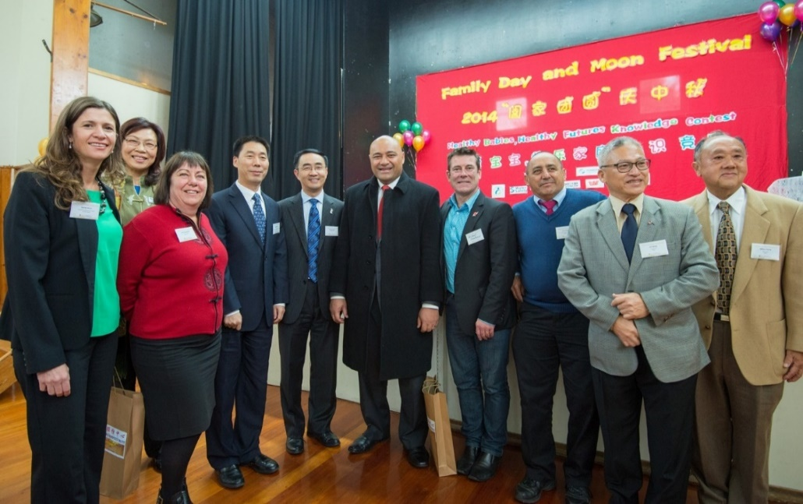
Range of funding contracts & sources
Central Government, eg.
DIA
MSD
MOJ
MBIE
TEC
ACC
DHBs
Electoral Commission
NZTA etc…
Local government, eg.
Auckland Council
-Local Boards
Other philanthropic groups, eg.
Foundation North (ASB CT)
Skycity Community Trust
Water Safety NZ
Auckland Airport Community Trust
Others individual donations etc etc…

Slide 15
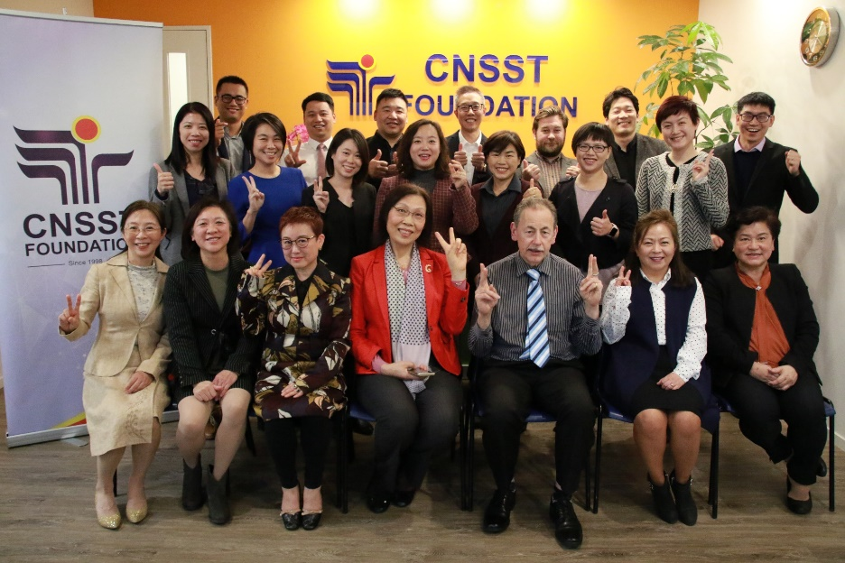
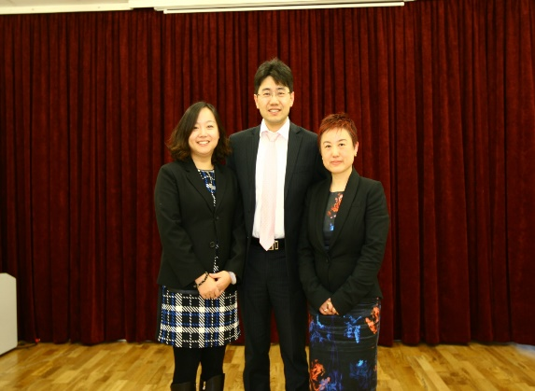
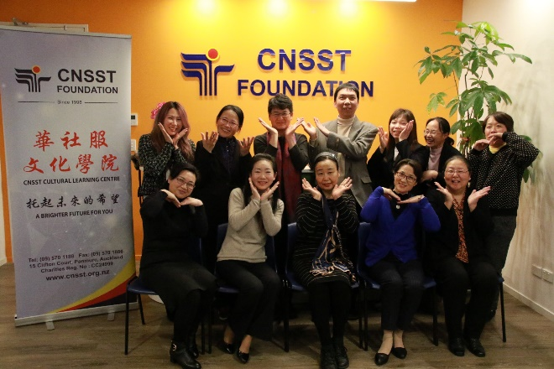
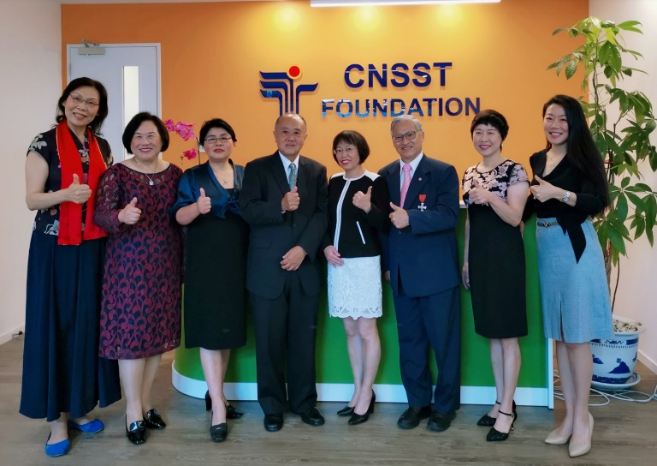
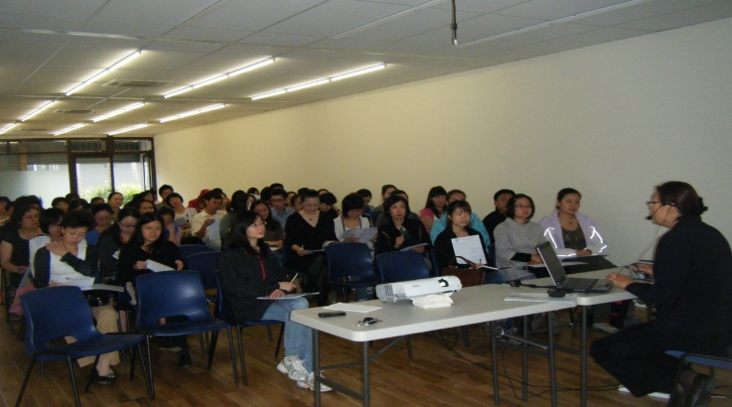
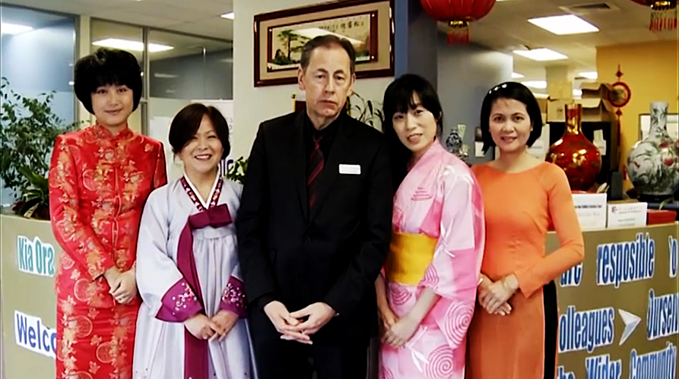
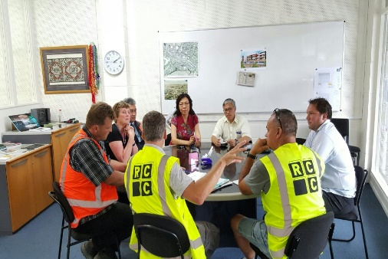
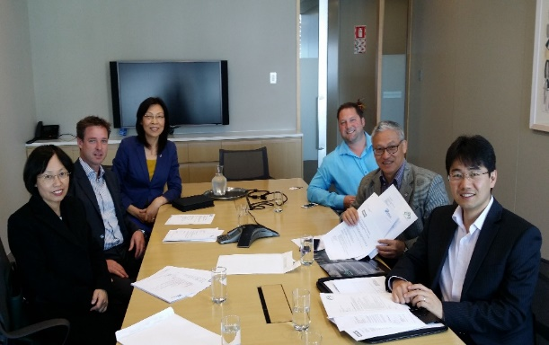
23 FT, 12 PT, 90 contractors & 50+ volunteers
work with over 15,000 clients p.a.

Slide 16
CNSST Large Client Base-F18~19
-Social Services:
social work & counselling: 2488+
Employment services: 1129
Settlement support: 860+
- Education:
EI: English for migrants: 533
CLC: youth cultural programmes: 51,755 participants
Vocational training: 185+
Social Housing: 51 Asian seniors
- International Projects: 245
-Civic participation: 131 groups(2000+ individuals)
-General enquiry: 15,800+

Slide 17
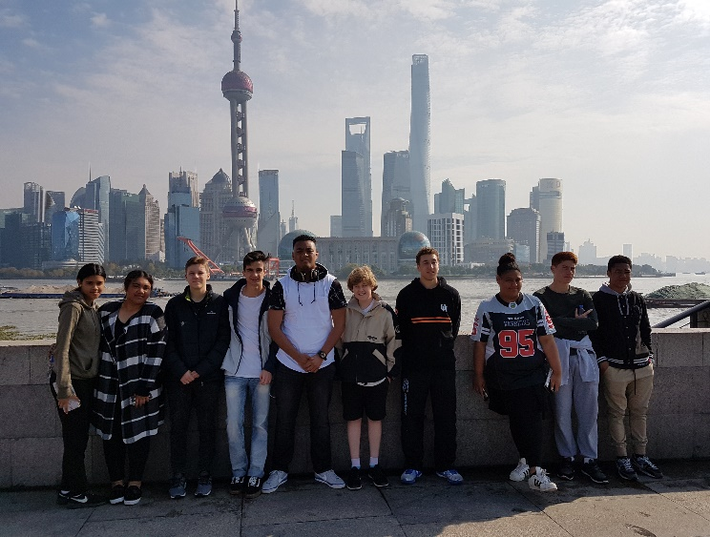
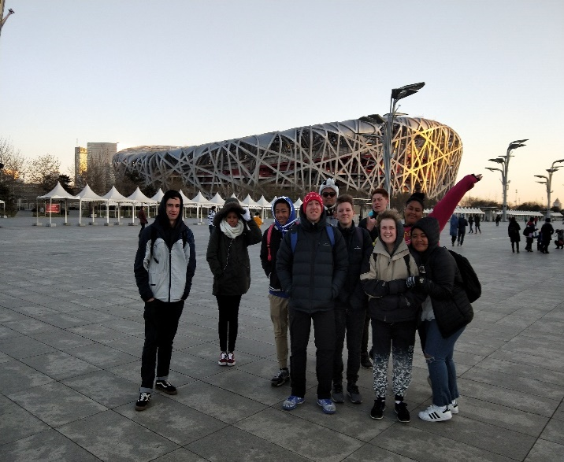
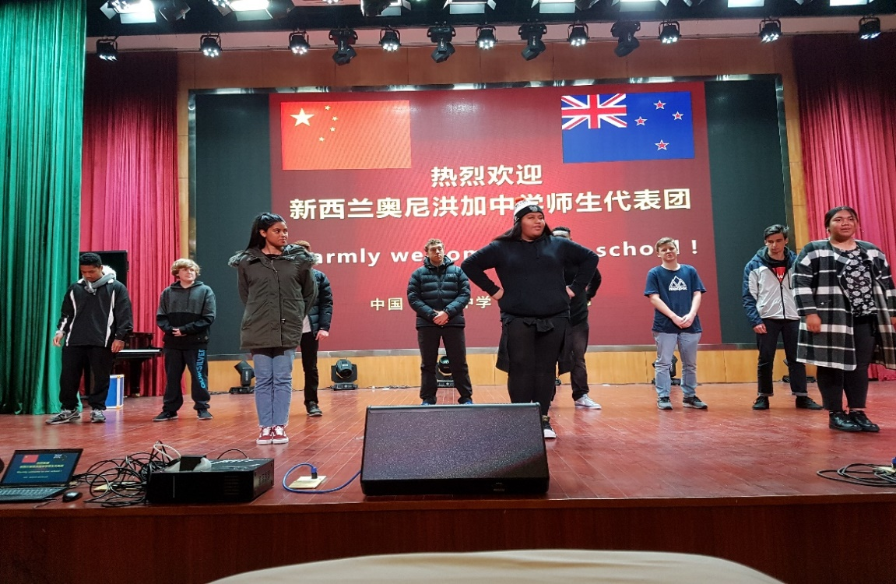
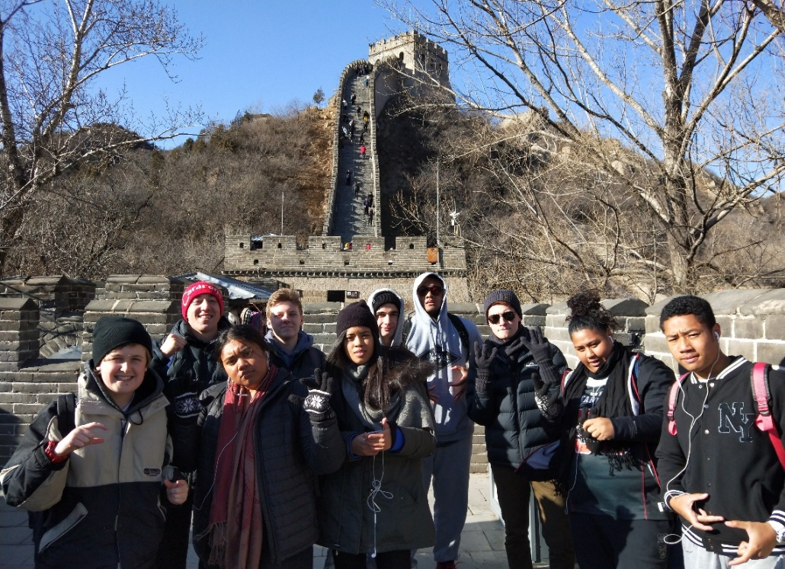
Engage with wider communities, eg.
Kiwi-Dragon Youth Cultural Exchange Scholarship
Financial support to local Non-Chinese youth for a cultural experience trip in China

Slide 18
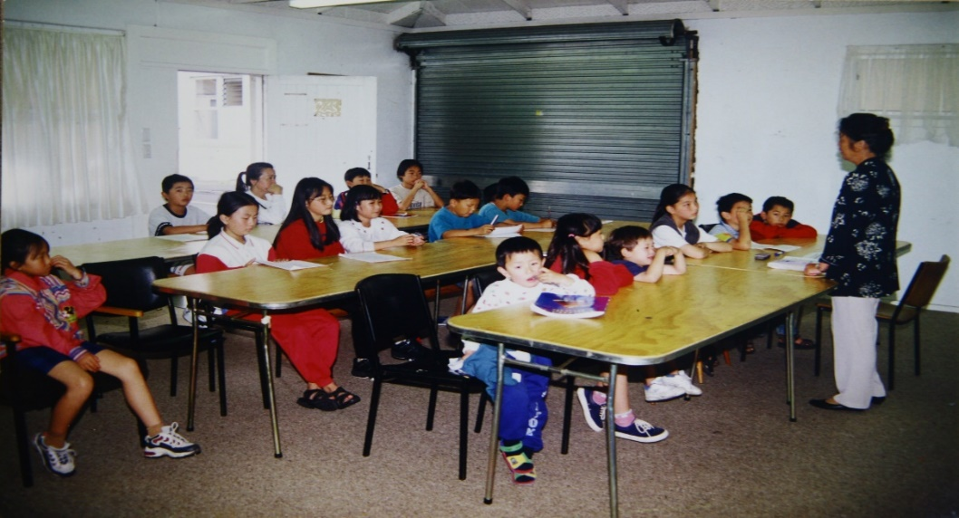
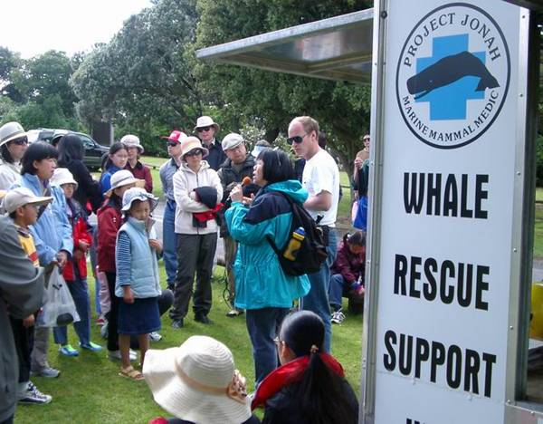
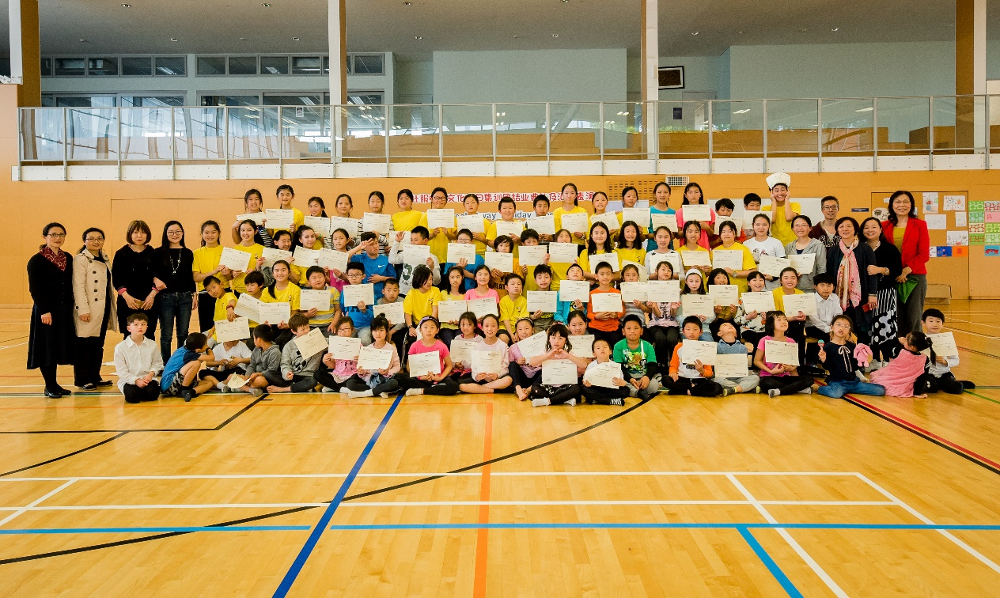
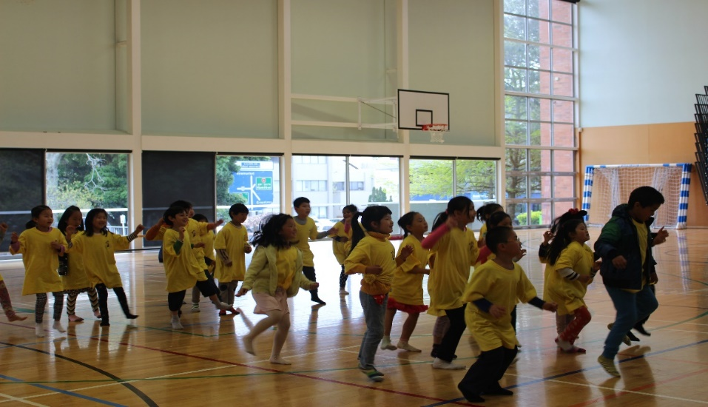
Youth Holiday Cultural Programme
Over 1,800 young people per week

Slide 19
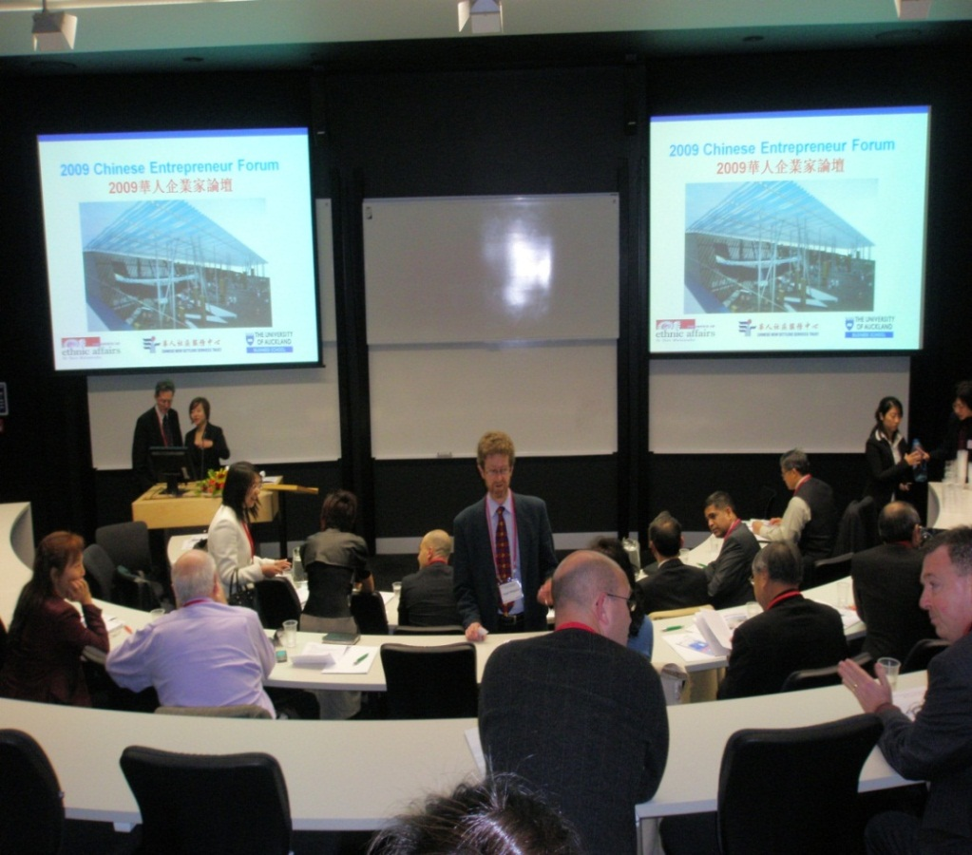
On-going engagement with government and other sectors e.g. Chinese Entrepreneur Forum at Auckland University e.g. Chinese Cultural Competency training Programme for NZ police frontline officers etc etc…

Slide 20
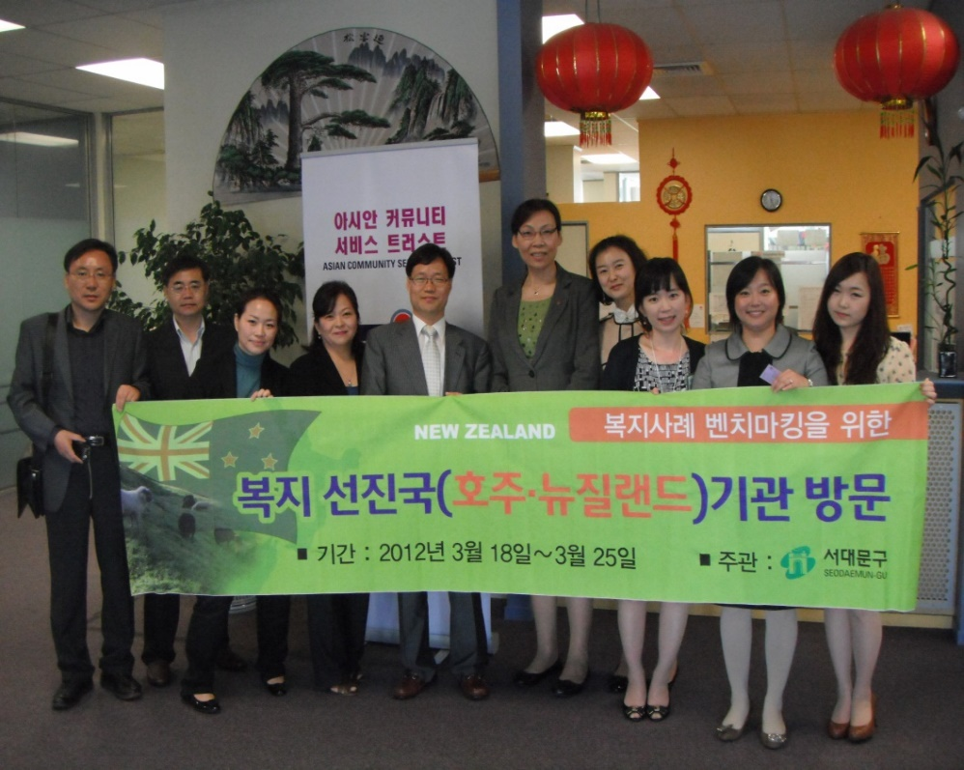
Visitors and delegations from around the world, eg. China, Korean, Hong Kong, Macau, USA & Germany

Slide 21
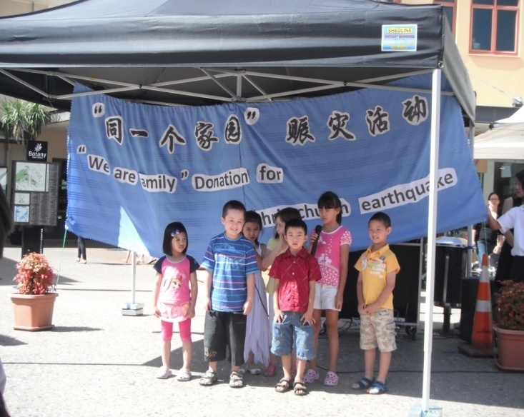
Donations collected from the Asian community for earthquake relief eg. Sichuan 2008 & Christchurch 2011

Slide 22
CNSST Long Term Strategy
After CNSST establishing 30 years, CNSST aims to be developed itself as an “Asian community hub” and achieve the goal of being “CNSST Foundation” which a successful social enterprise including social services, education and social housing running in a financially sustainable way. Our Trust will therefore be capable of making a significant positive impact on local communities and enabling Asian migrants to more fully participate in and contribute to New Zealand society in social, economic, cultural & environmental aspects.

Slide 23
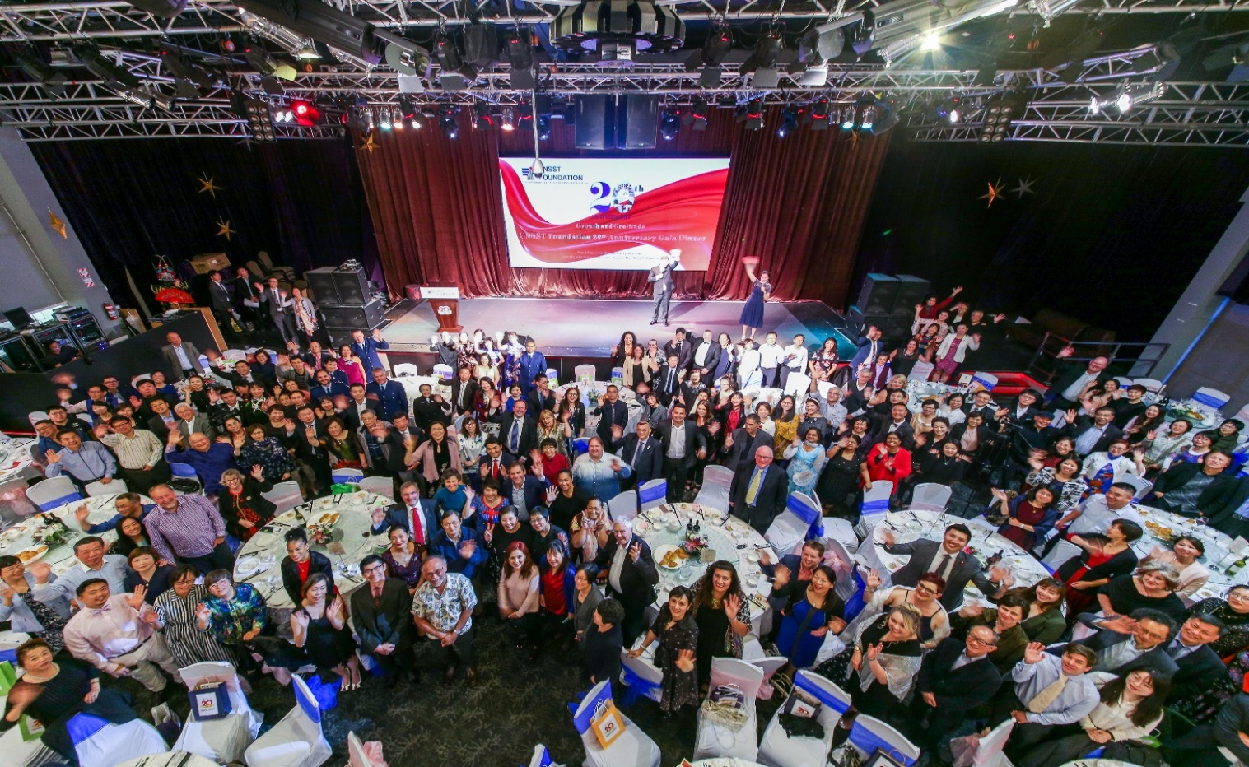
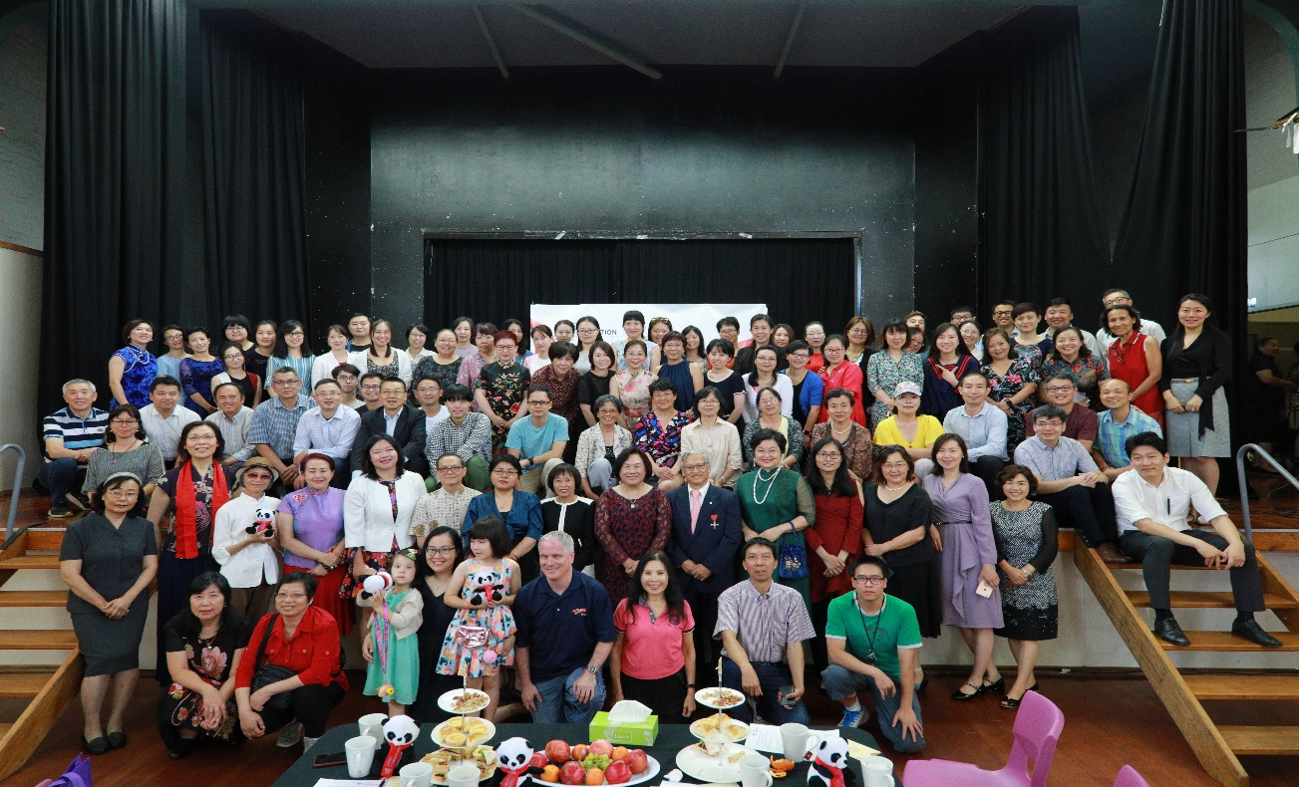
CNSST 20th Anniversary Celebration

Slide 24
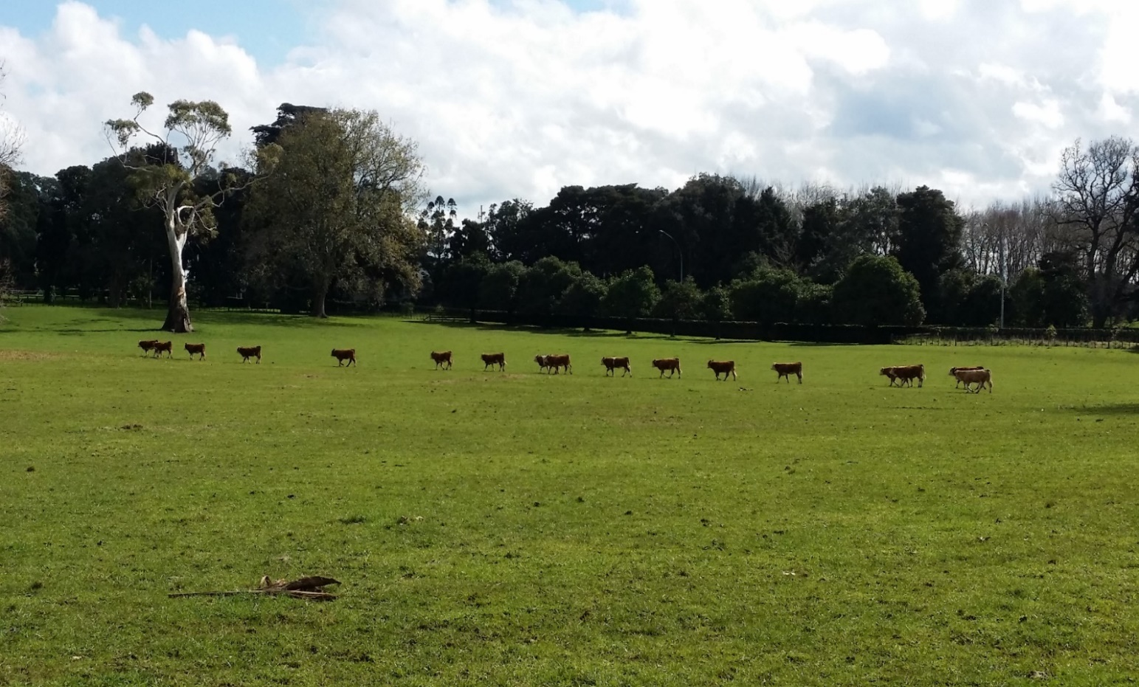
Thank You!
Passion, Vision & Action!
We make the ROAD by walking!

